Slide 1

Armed Forces College of Medicine
AFCM

Slide 2
Cardiac Cycle, Heart Sounds and Murmurs
Third year
By: Tarek Abdel-Hameed Kafafy, MD, PhD
Mina Samy, MD MRCP-UK

Slide 3
Cardiac Cycle
Cardiac cycle - one complete contraction and relaxation of all four chambers of the heart (0.8 sec)
Atrial systole (atrial contraction) occurs during ventricles diastole (ventricle relaxation)
Ventricular systole (ventricle contraction) occurs during atrial diastole (atrial relaxation)
Quiescent period occurs when all four chambers are relaxed at same time (in a diastolic phase)

Slide 4
Timing of Cardiac Cycle
In a resting person
– atrial systole last about 0.1 sec
– ventricular systole last about 0.3 sec
– quiescent period, when all four chambers are in diastole, about 0.4 sec
Total duration of the cardiac cycle is therefore 0.8 sec in a heart beating 75 bpm.
The more rapid the heart rate, the shorter is the cardiac cycle. HR= 200 bpm 🡪 cardiac cycle= 0.3 sec.

Slide 5
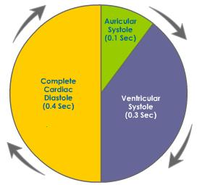
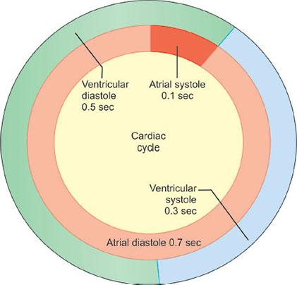
Timing of Cardiac Cycle
To analyze these events which occur in all four chambers, it is best to follow the events which occur in a single chamber.
We will focus on events which occur in a ventricle.

Slide 6
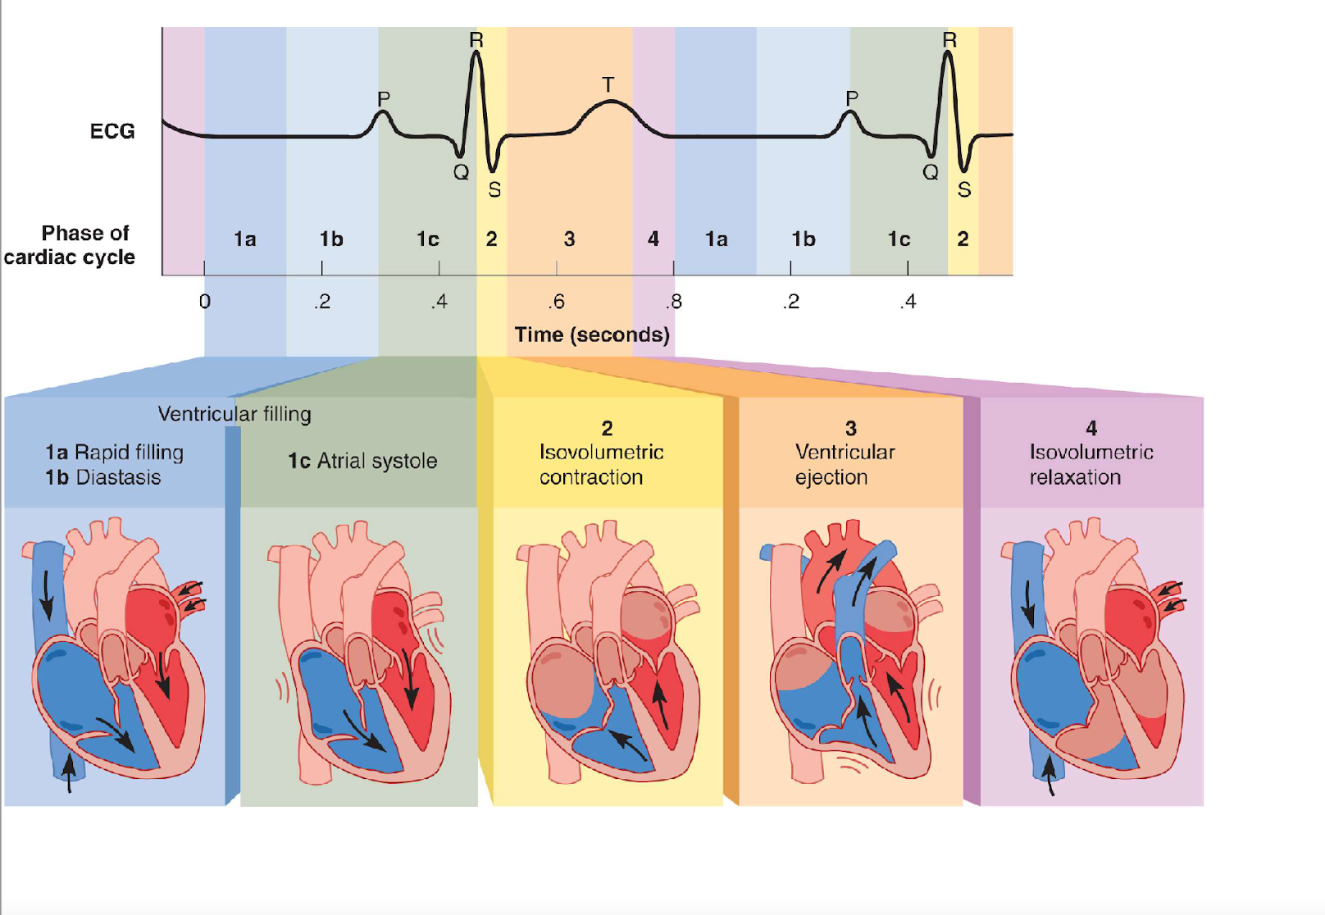
Phases of Cardiac Cycle

Slide 7
Events of Ventricular Filling (1 of 3)
Events associated with ventricular diastole = Ventricular Filling
– Ventricles expand
– Ventricular pressure drops below pressure in atria
– AV valves open and blood flows into the ventricles

Slide 8
Events of Ventricular Filling (2 of 3)
Ventricular filling occurs in three phases:
– rapid ventricular filling - first one-third
• blood enters very quickly / before atrial
systole begins
– diastasis: diastole continues in atria - second one- third
• marked by slower filling
• P wave occurs at the end of diastasis
– atrial systole - final one-third
• atria contract

Slide 9
Events of Ventricular Filling (3 of 3)
Reaching the “end-diastolic volume” of ventricles (EDV)
– amount of blood contained in ventricles at the end of ventricular filling
– same volume in right and left ventricle // must never be different
– 130 mL of blood in each ventricle at end of ventricular diastole

Slide 10
Events of Iso-volumetric Contraction (1 of 2)
Atria repolarize and relax // remain in diastole for the rest of the cardiac cycle
• Ventricles depolarize
– this initiates the QRS complex
– Depolarization followed by the contraction
• AV valves close as ventricular blood pressure increases // forcing blood to surge back against the AV cusps
– heart sound S1 occurs at the beginning of this phase // closing of AV valves

Slide 11
Events of Iso-volumetric Contraction (2 of 2)
Now entering the ‘isovolumetric’ contraction phase.
– ventricles contracting but they do not eject blood // why?
– Note: both AV and semilunar values are STILL CLOSED
– because pressure in the aorta (80 mm Hg) and in pulmonary trunk (10 mm Hg) is still greater than the pressure in the two ventricles
• Cardiocytes exert force, but with all four valves closed, the blood cannot go anywhere 🡪 rapid increase in pressure

Slide 12
Events of Ventricular Ejection (1 of 2)
ejection of blood begins when the ventricular pressure exceeds arterial pressure and forces semilunar valves open.
– pressure peaks in left ventricle at about 120 mm Hg and 25 mm Hg in the right ventricle.
• blood spurts out of each ventricle rapidly at first – rapid ejection
then more slowly under reduced pressure – reduced ejection
ventricular ejections last about 200 – 250 msec

Slide 13
Events of Ventricular Ejection (2 of 2)
stroke volume (SV) of about 70 mL of blood is ejected of the 130 mL in each ventricle
– ejection fraction of about 54%
– as high as 90% in vigorous exercise
– prolonged contraction of ventricles associated with slow calcium channels 🡪 the plateau of the cardiomyocyte action potential
end-systolic volume (ESV) 🡪 60 mL of blood left behind
T wave occurs late in this phase

Slide 14
Isovolumetric Relaxation
Early ventricular diastole 🡪 when T wave ends and the ventricles begin to expand
Elastic recoil and expansion would cause pressure to drop rapidly and suck blood into the ventricles
– blood from the aorta and pulmonary briefly flows backwards
– filling the semilunar valves and closing the cusps
– creates a slight pressure rebound that appears as the dicrotic notch of the aortic pressure curve

Slide 15
Isovolumetric Relaxation
heart sound S2 occurs as blood rebounds from the closed semilunar valves and the ventricle expands
‘isovolumetric’ because semilunar valves are closed and AV valves have not yet opened 🡪 ventricles are therefore taking in no blood
when AV valves open, ventricular filling begins again

Slide 16
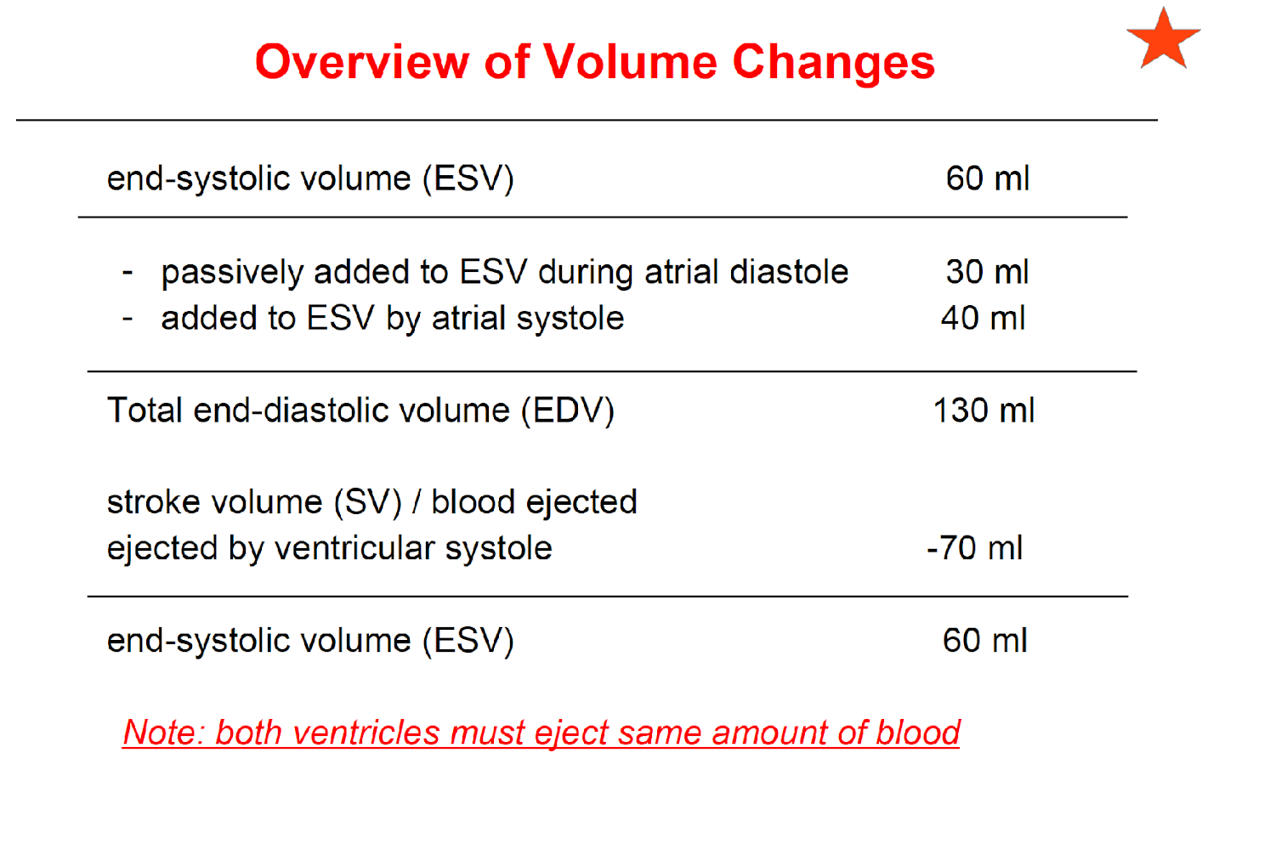
Volumetric changes

Slide 17
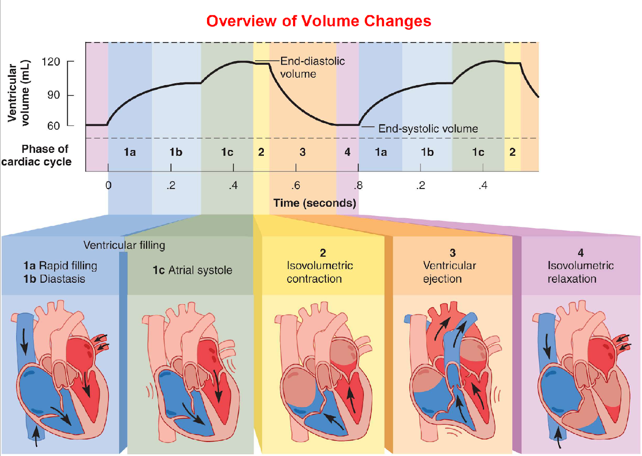
Volumetric changes

Slide 18
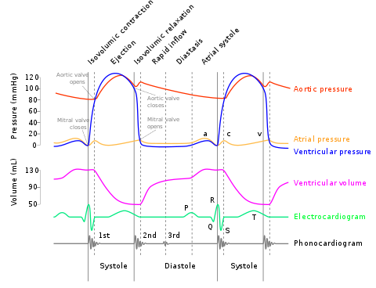
Cardiac cycle

Slide 19
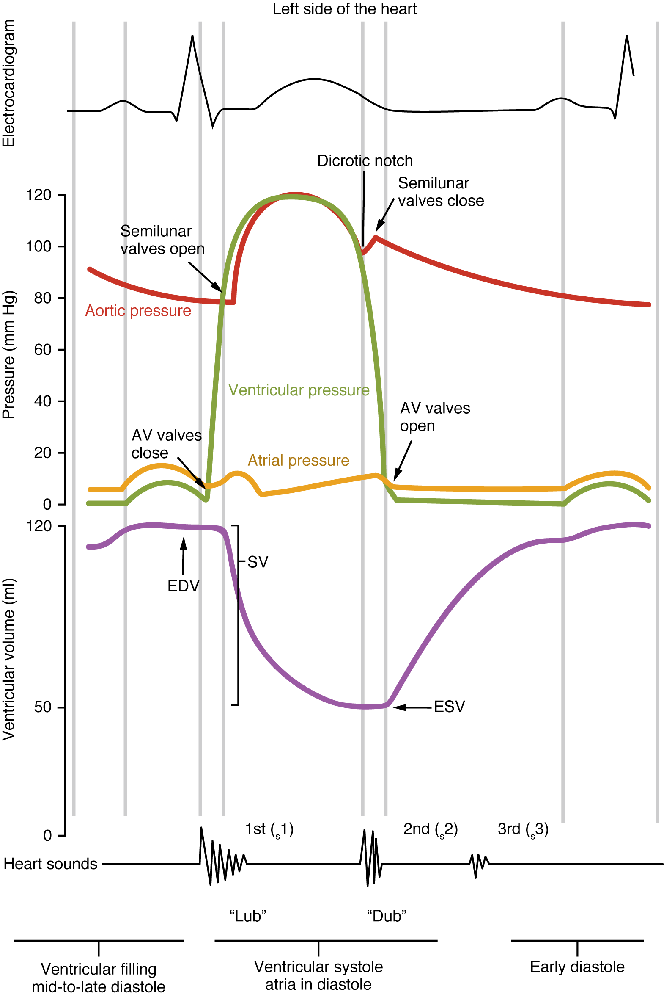
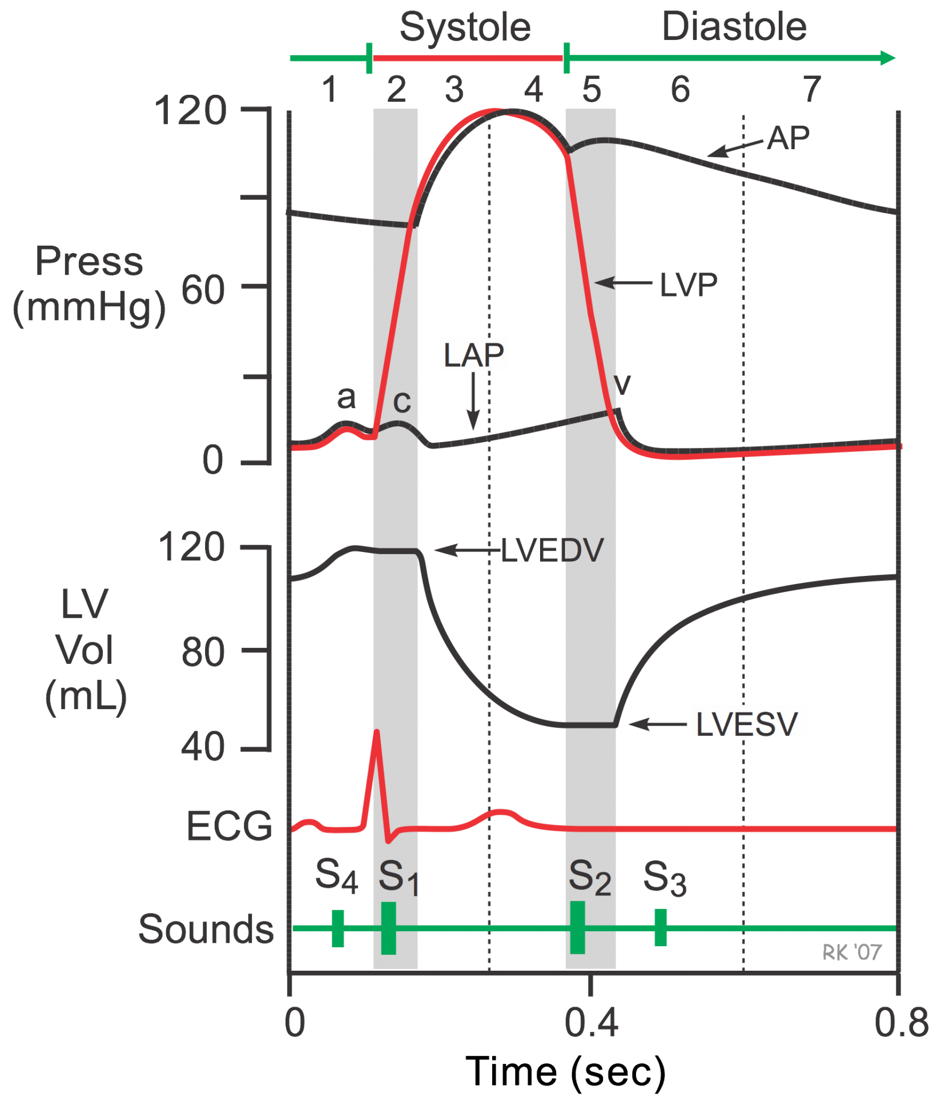
Cardiac Cycle

Slide 20
Auscultation
Heart sounds.
Added sounds.
Murmurs.
Pericardial rub.

Slide 21
Heart sounds
Normal heart valves make a sound only when they close.
The ‘lub-dub’ sounds are caused by closure of the atrioventricular (mitral and tricuspid) valves followed by the outlet semilunar (aortic and pulmonary) valves

Slide 22
Heart sounds
first heart sound (S1), louder and longer “lubb”, occurs with closure of AV valves, turbulence in the bloodstream, and movements of the heart wall
second heart sound (S2), softer and sharper “dupp” occurs with closure of semilunar valves, turbulence in the bloodstream, and movements of the heart wall
S3 - rarely heard in people over 30

Slide 23
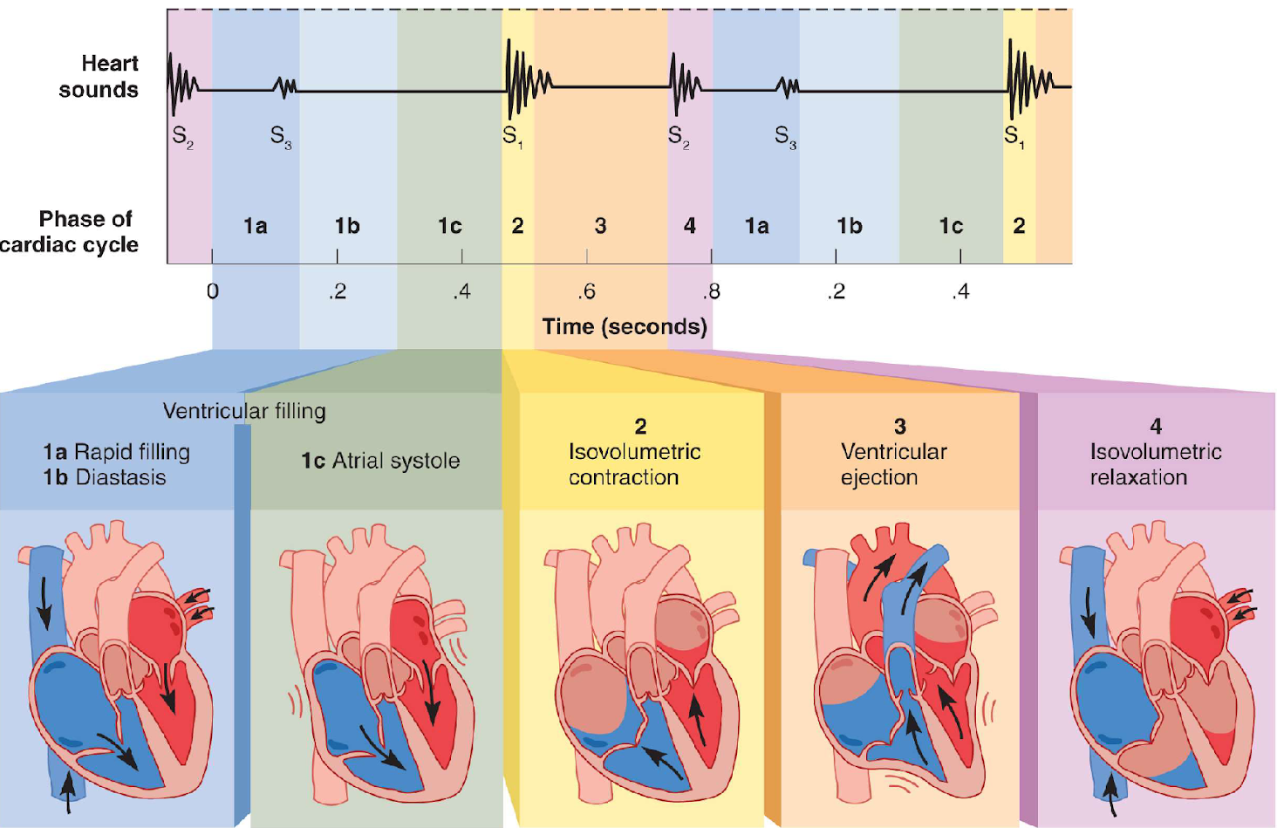
Heart sounds

Slide 24
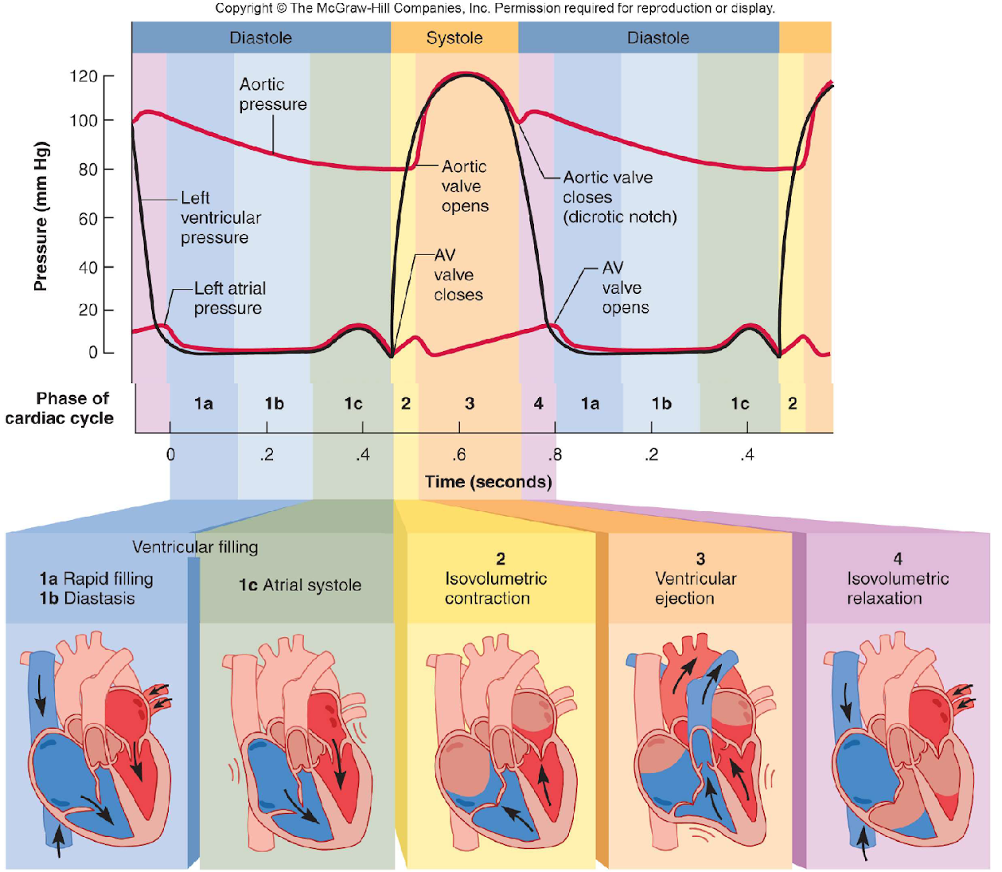
Heart sounds

Slide 25
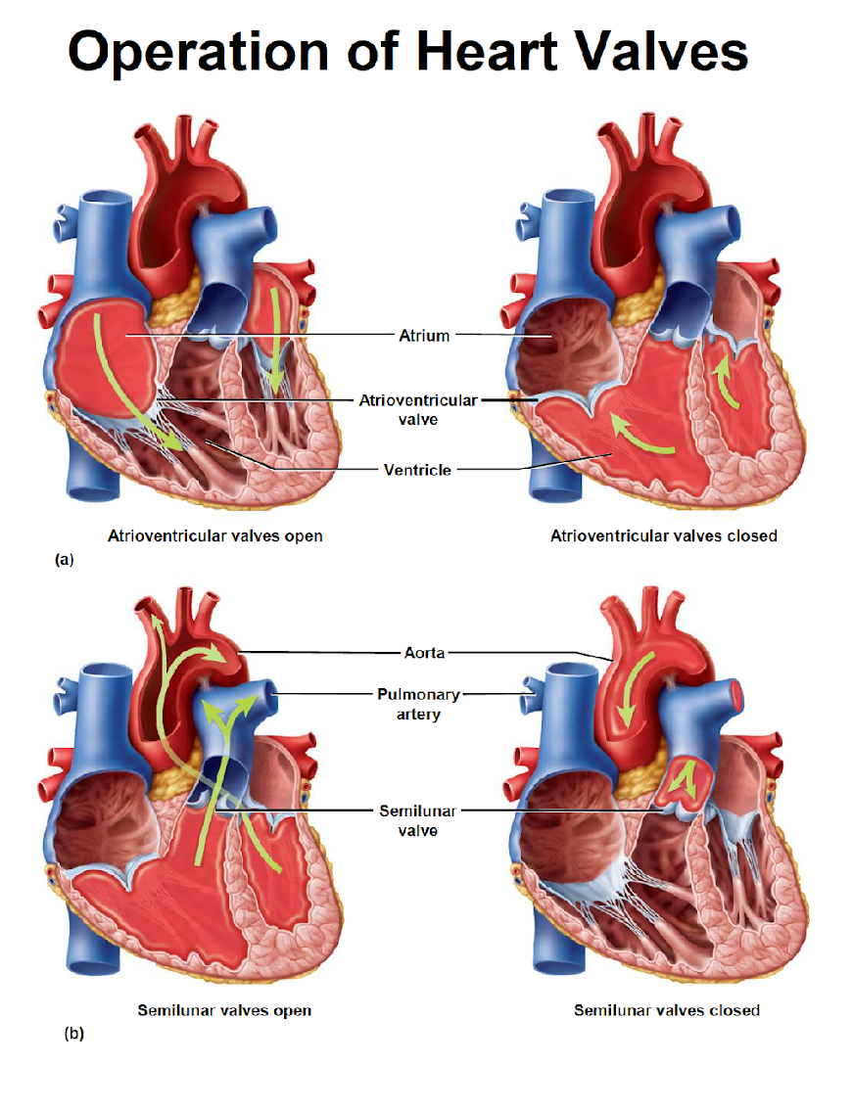
Heart sounds

Slide 26
First heart sound (S1)
A loud (accentuated) S1 is heard in:
Mitral stenosis (mitral leaflets are still widely open at the onset of systole):
- This occurs because the increased left atrial pressures in early mitral stenosis force the mobile portion of the mitral valve leaflets far apart. At the onset of ventricular systole, they are forced closed from a relatively far distance, resulting in a loud S1.
Short PR interval (mitral leaflets are still widely open at the onset of systole)
Hyperdynamic circulation.

Slide 27
First heart sound (S1)
A soft (muffled) S1is heard in:
Mitral regurgitation (mitral valve leaflets fail to close properly)
Long PR interval (mitral leaflets already partly closed at the onset of systole)
Low cardiac output.

Slide 28
Second heart sound (S2)
A loud A2 is heard in:
Systemic hypertension (forceful aortic valve closure).
A soft A2 is heard in:
Calcific aortic stenosis (reduced cusp mobility)
Aortic regurgitation (failure of cusp coaptation).

Slide 29
Second heart sound (S2)
A loud P2 is heard in:
Pulmonary hypertension (forceful pulmonary valve closure).
Abnormal splitting of S2

Slide 30
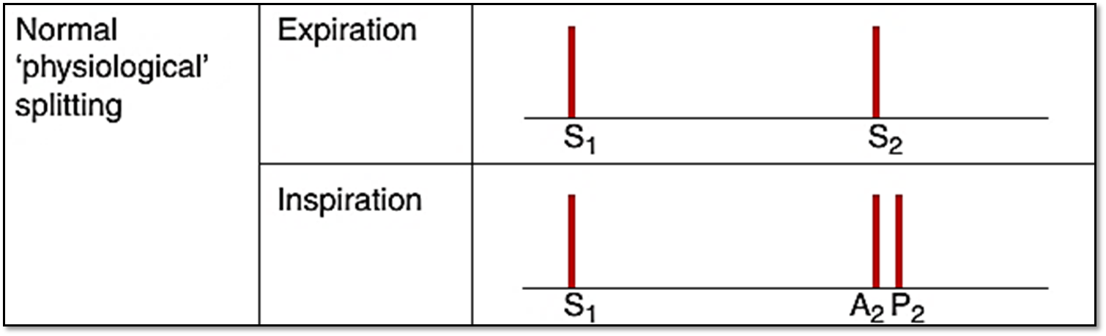
Splitting of S2

Slide 31
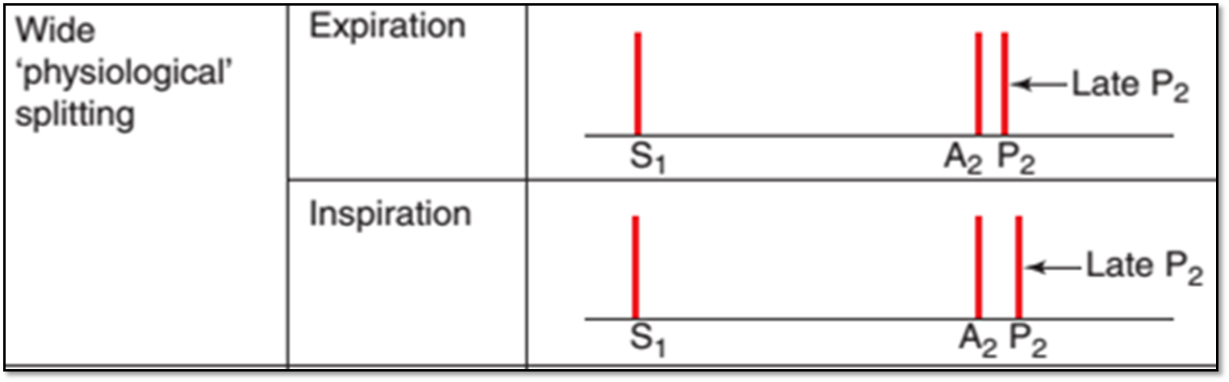
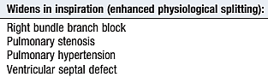
Enhanced Splitting of S2

Slide 32
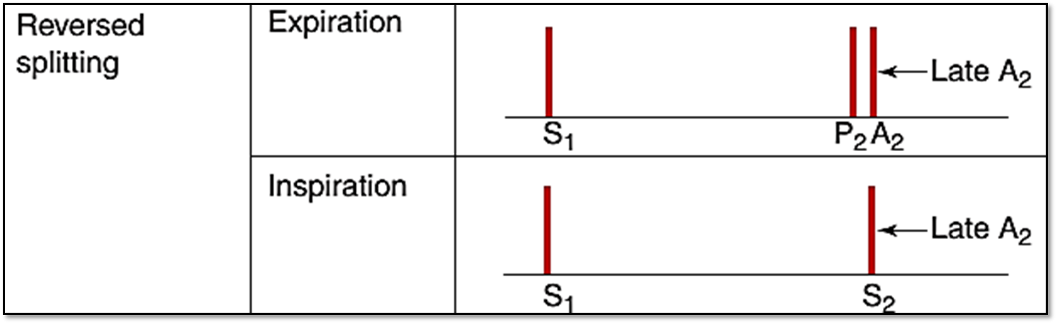
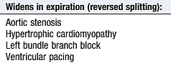
Reversed Splitting of S2

Slide 33
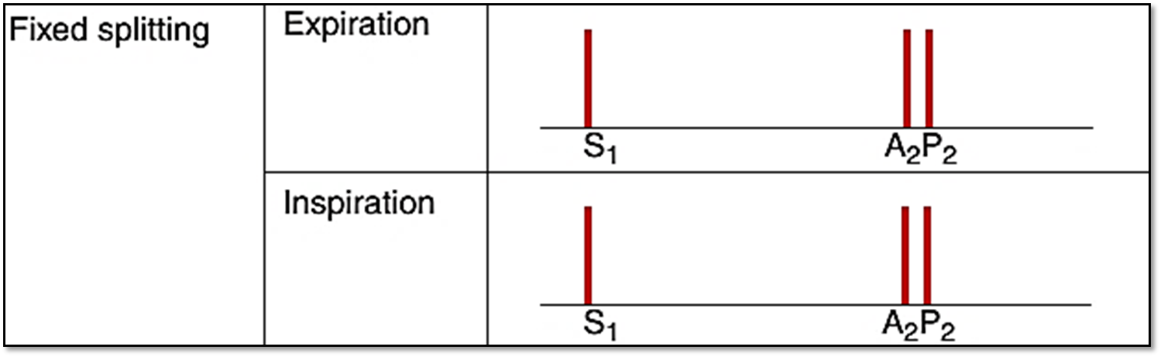
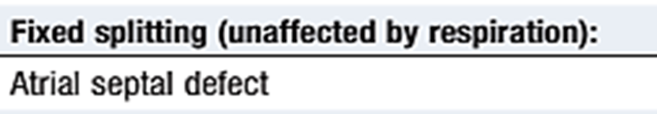
Fixed Splitting of S2

Slide 34
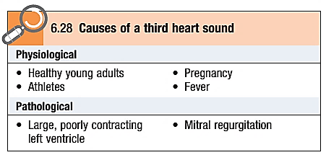
Additional sounds: S3
Third heart sound (S3)
It coincides with rapid ventricular filling immediately after opening of the AV valves and is therefore heard after the second as ‘lub-dub-dum’.

Slide 35
Additional sounds: S4
Fourth heart sound (S4)
It is always pathological and is caused by forceful atrial contraction against a non-compliant or stiff ventricle.
It occurs just before S1(da-lub-dub).
It is most often heard with left ventricular hypertrophy in hypertension, aortic stenosis or hypertrophic cardiomyopathy.

Slide 36
Other extra heart sounds
Ejection clicks.
Opening snap.
Sounds from artificial heart valves.

Slide 37
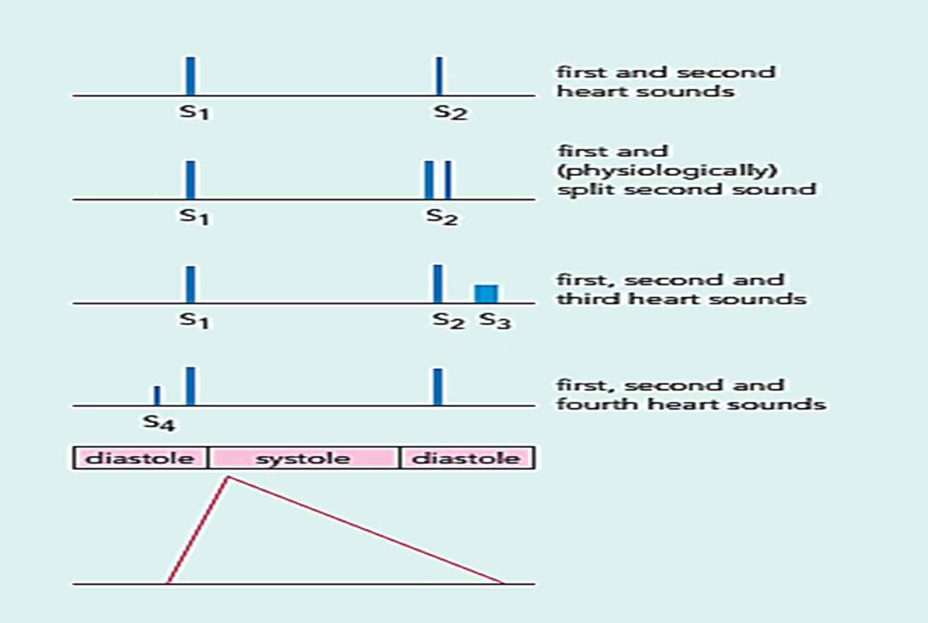
Heart sounds

Slide 38
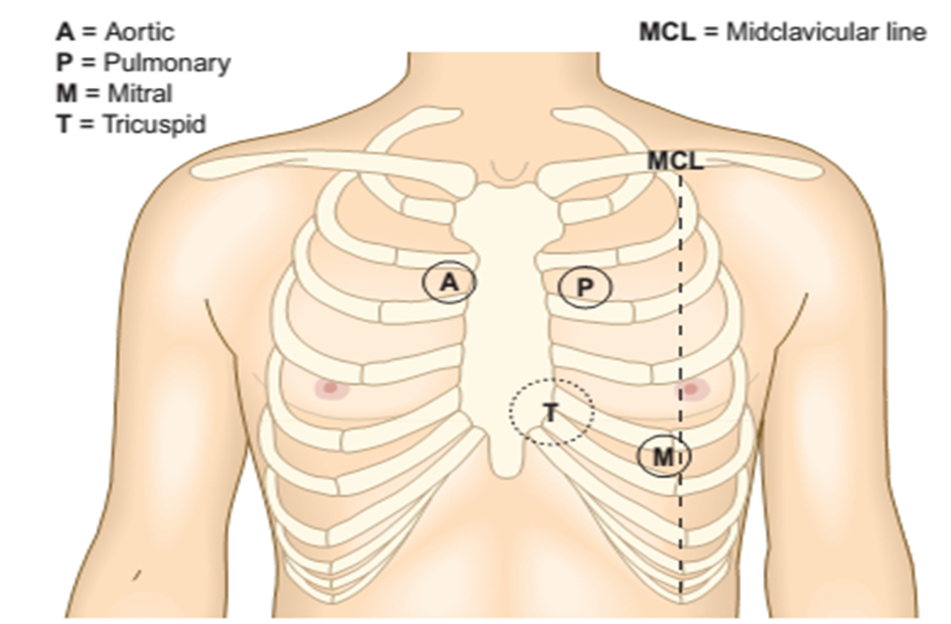
Heart murmurs

Slide 39
When to hear a murmur
When there is turbulence of flow
When a valve doesn’t open well when it’s supposed to open like aortic stenosis, mitral stenosis,….
Or when a valve doesn’t close well when it is supposed to be closed like aortic regurgitation, mitral regurgitation

Slide 40
Heart murmurs
Timing.
Duration.
Location.
Radiation.
Character and pitch.
Intensity.

Slide 41
Systolic murmurs
Aortic stenosis/ pulmonary stenosis → does not open well during systole → systolic murmur
Aortic and pulmonary valves are not open during isovolumetric contraction → ejection systolic
Mitral and tricuspid regurgitation→ does not close well during systole → systolic murmurs
There is nothing to prevent the mitral and tricuspid valves to allow blood during isovolumetric contraction→ pansystolic murmur

Slide 42
Diastolic murmurs
Aortic regurge/ pulmonary regurge → does not close well during diastole → diastolic murmur
In AR and PR, blood can pass during isovolumetric relaxation → early diastolic murmurs
Mitral and tricuspid stenosis→ does not opem well during diastole → diastolic murmurs
Mitral and tricuspid are not open during isovolumetric relaxation phase → mid diastolic murmurs

Slide 43
Take Home Message
Don’t forget to comment on
Heart Sounds: S1, S2, Any additional sounds
If there is a murmur comment on
Timing.
Duration.
Location.
Radiation.
Character and pitch.
Intensity.

Slide 44
References
Michael Crawford (2017): Current Diagnosis and Treatment Cardiology, fifth edition; MCGrow Hill Edu.
Benjamin IJ, Griggs RC, Wing EJ, Fitz JG (Eds.) (2016). Andreoli and Carpenter’s Cecil Essentials of Medicine (9th ed.). Philadelphia, PA: Elsevier Saunders.
Binesh-Marvasti T, McQueen S (Eds) (2018). Essential Med Notes 2018: Comprehensive Medical Reference and Review for USMLE II and MCCQE (34th ed.). Toronto, Ontario, Canada: Toronto Notes for Medical Students, Inc.

Slide 45
Thank You

